Slide 1
Feature Extraction Technique Based Character Recognition Using Artificial Neural Network
- Submitted By
Rijin Thomas

Slide 2
Content
Problem Definition
Methodology
Implementation
Result
Conclusion and Future works
References

Slide 3
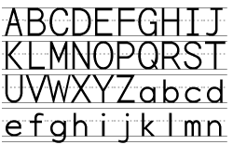
Problem definition
◆ Identifying English handwritten characters.

Slide 4
Problem definition(continue)
◆ Current Approaches
◆ OCR - What it is ?
Optical Character
Recognition, or OCR, is a
technology that enables you to convert different types of documents, such as scanned paper documents, PDF files or images captured by a digital camera into editable and searchable data

Slide 5
Problem definition(continue)
◆ Solution
◆ Apply New Feature extraction Technique
◆ Using Artificial Neural Network
◆ Expected 100% accuracy of character identification.

Slide 6
Methodology
Pre Processing
Segmentation
Feature Extraction
Classification and recognition

Slide 7
Preprocessing
Pre Processing
Preprocessing stage has several tasks to be done:
Binarization
Noise filtering
Smoothing
normalization
Segmentation
Feature Extraction
Classification and recognition

Slide 8
Segmentation
Pre Processing
An image of the sequence of characters is decomposed into sub- images of individual character.
Segmentation
Feature Extraction
Classification and recognition

Slide 9
Feature Extraction
Pre Processing
Feature Extraction Based on Character Geometry
Segmentation
It extracts different line types that
form a particular character.
The feature extraction technique
Feature Extraction
explained was tested using a Neural
Network which was trained with the feature vectors obtained from the system proposed.
Classification and recognition

Slide 10
Feature Extraction(continue)
Pre Processing
Zoning
17 x 17
Segmentation
Feature Extraction
Classification and recognition

Slide 11
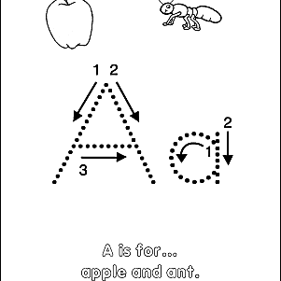
Feature Extraction(continue)
Pre Processing
Starters
Segmentation
Feature Extraction
Classification and recognition

Slide 12
Feature Extraction(continue)
Pre Processing
Intersections
Segmentation
Feature Extraction
Classification and recognition

Slide 13
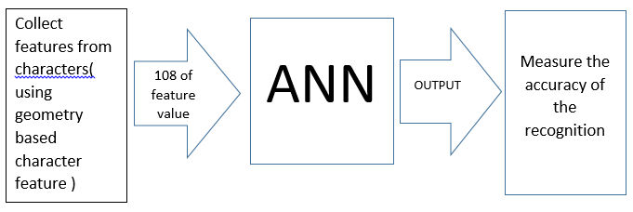
Classification and recognition
Pre Processing
Design for the Artificial Neural Network.
Segmentation
Feature Extraction
Classification and recognition

Slide 14
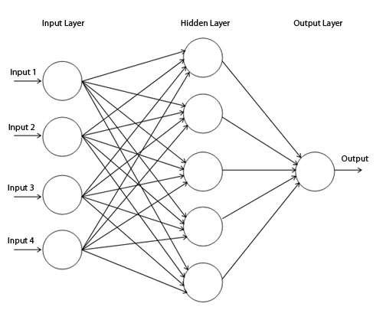
Artificial neural Network
Pre Processing
Segmentation
Feature Extraction
Classification and recognition

Slide 15
Artificial Neural Network(continue)
Pre Processing
Parameters Used for the ANN
Number of layers | Node of layers
3 | Input | 108
 | Hidden | 76
 | Output | 34
Segmentation
Feature Extraction
Number
layers
3
of Node of layers
Input 108
Hidden 78
Output 34
Classification and recognition

Slide 16
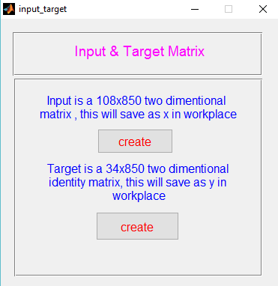
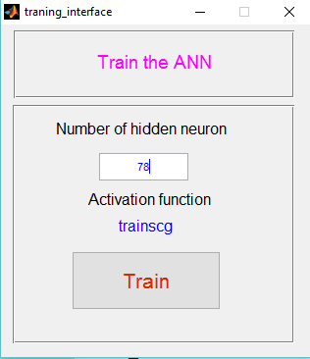
Implementation

Slide 17
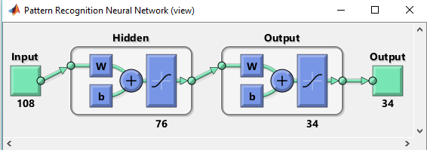
Implementation

Slide 18
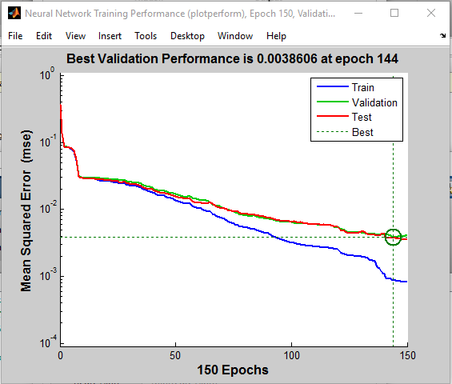
Result
Iterations Vs Mean squared error

Slide 19
Result
Using a PC with Intel core i5 – 6200u @ 2.30 GHz processor and 8GB RAM with Windows 10 premium environment.
Technique Used | Total Character in database | No: of Training characters | No: of Testing characters | Performanc e
Artificial Neural Network | 850 | 680 | 170 | 82.1%

Slide 20
Conclusion
The has an
proposed
neural network
architecture
ability to classify
the character
patterns in some degree.
But it shows
difficulties during the
classification of unknown samples. Since as a future enhancement, it is expected to improve the current architecture

Slide 21
Conclusion and future works
Make the system more font independent
Increase the number of nodes and layers in ANN.
Try different recognition algorithms such HMM(Hidden Markov Model).
Improve the separation of touching characters.
Improve the efficiency of the feature extraction method.
Improve the system to identify any other characters.

Slide 22
Reference
https://www.abbyy.com/en-apac/finereader/about-ocr/what-is- ocr/
https://in.mathworks.com/?requestedDomain=www.mathworks.co m
Dinesh Deleep. A feature extraction technique based on character
geometry for character recognition.
SANDHYA ARORA,DEBOTOSH BHATTACHARJEE,MITA NASIPURI, L.MALIK,M.KUNDU, D.K.BASU, Performance Comparison of SVM and ANN for Handwritten Devanagari Character Recognition, International Journal of Computer Science Issues (IJCSI) , Vol. 7 Issue 4, p18. (July 2010)
RANPREET KARU,BALJITH SINGH, A hybrid neural Approach for Character Recognition System,(IJCSIT) International Journal of Computer Science and Information Technologies, Vol. 2 (2) , 721- 726. ( 2011)

Slide 23
Thank You

